Slide 1
Website Development Plan:
Gathering Information
Title: Sparkline
Tagline: Choose best with us
Type of E-commerce website: Gaming Accessories (keyboard, mouse and headset)

Slide 2
3. Target Audience:
Gen z and Millennial who are interested in latest gadgets and innovations.
Planning:
Sitemap and Wireframe Creation
Estimated time 1 to 2 weeks

Slide 3
2.Main goals
Sparkline website offers a wide variety of high-quality gaming accessories to ensure the product will meet the needs and preferences of customer, while having user-friendly website design.
Must offer multiple shipping options for local and foreign countries.
Must be responsive at all devices.

Slide 4
SPARKLINE
HOME
Products
Shop
Community
Account
search
Featured products
Cart
Rewards
Login/Register
Gaming Keyboards
View Cart
Wish list
Checkout
Gaming Mice
Continue Shopping
Logout
Gaming Headsets
Footer
About Us
Contact Us
My Account

Slide 5

Logo
Search bar
Cart
Products Shop Community Account
Carousel
Mice
Keyboards
Headset
Product 1
Product 2
Learn more
Learn more
Video showcasing Product 3
Blog Post
Blog post 1
Blog post 2
Blog post 3
Footer
HOME

Slide 6
Logo
Search bar
Cart
Products Shop Community Account
Product name
Product picture
Product picture
Product picture
Product picture
Product picture
Product picture
Footer
Products

Slide 7
Logo
Search bar
Cart
Products Shop Community Account
Product picture
Product Title
Product Price
Product description, additional information
Related products
Product picture
Product picture
Product picture
Read More
Read More
Read More
Footer
Product Info

Slide 8
Logo
Search bar
Cart
Products Shop Community Account
Product picture
Product Name
Product 1
Product name
Product brand / price
image
Connectivity:
Wired
wireless
Color : 0000
In stock
[] yes (2)
BUY NOW
Add to cart
Product 1
Product name
Product brand / price
image
BUY NOW
Add to cart
Product 1
Product name
Product brand / price
image
BUY NOW
Add to cart
Footer
Shop

Slide 9
Logo
Search bar
Cart
Products Shop Community Account
Product picture
Product Name
Product 1
Product name
Product brand / price
Your Cart
x
image
Product picture
Product name
Product price
Connectivity:
Wired
wireless
Color : 0000
In stock
[] yes (2)
BUY NOW
Add to cart
Product 1
Product name
Product brand / price
image
- 1 +
REMOVE
BUY NOW
Add to cart
Product picture
Product name
Product price
Product 1
Product name
Product brand / price
image
BUY NOW
Add to cart
- 1 +
REMOVE
Sub total product price
VIEW CART
Footer
Add to cart

Slide 10
Logo
Contact
Shipping address
Your Cart
Email
Product picture
Product name
Product price
First name
Last name
Address
Total price :
Region
Phone number
Payment Option
Pay now
Checkout Form

Slide 11
Logo
Search bar
Cart
Products Shop Community Account
Login
Please enter you username and password:
--New to Sparkline?--
Email
Password
Login
Create your Sparkline account
Footer
Login

Slide 12
Logo
Search bar
Cart
Products Shop Community Account
Create account:
First Name
Last Name
Email
Password
Create my account
Footer
Register

Slide 13
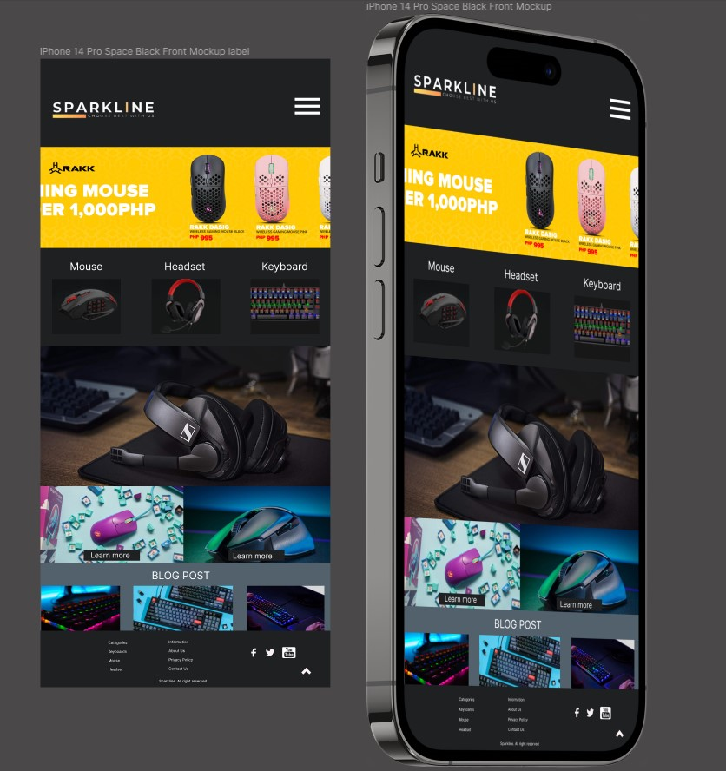

Slide 14
